Slide 1
Class 31: Correlation, causality, and counter-factuals Wednesday, April 3
INFO 3402: Representations of Data Professor Brian Keegan brian.keegan@colorado.edu

Slide 2
Module Assignment 06
In-class critical response process feedback on Friday, April 12
Due Monday, April 15 by 11:59pm on Medium
Objective: Identify an example of a news story, op-ed, academic article, etc. making strong causal claims and do an EDA to explore alternative causal mechanisms
Summarize: What argument does the article make? What is the primary causal mechanism being claimed?
Identify: Identify alternative causal relationships. Use Hill’s framework to make a case for how this alternative could be a better explanation for the observed relationship. What kinds of data could illustrate this alternative relationship? What metrics would you employ to assess the superior explanation?
Analyze: Perform an EDA combining the data in the original argument with data for your alternative relationship. Show examples of the each causal relationship. Report, compare, and interpret the assessment metrics you identified.
Summarize: Discuss the who/what/where/when/why/how of your analysis comparing an alternative causal mechanism to the author’s mechanism? Other data, methods, mechanisms to explore in future?

Slide 3
Final project
New Critical Response Process schedule after spring break
CRP on final project progress: April 5, April 19
CRP on module assignments: April 12, April 26
Half of class present on final project proposal/progress each CRP session (5% of final grade)
Slide presentation with background/motivation, research question/hypothesis, data, methods, findings, discussion
Alternatively, some of the storytelling frameworks from above – if appropriate
Submit slides by 10:59am on Friday, April 5 on Canvas
Final project presentations in-class Week 16 (April 29, May 1) (10% of final grade)
Final project write-up to be submitted to class Medium as blog post by May 7 (20% of final grade)

Slide 4
Final project: Data-driven op-ed
In-class critical response process feedback on Friday, April 5 and Friday, April 19
Due May 7 on Medium
Objective: Write a data-driven op-ed that could be submitted to a newspaper, magazine, blog, etc.
Follow best practices for writing op-eds (see Canvas for links to resources)
700 words, current events, good storytelling, tight argument, compelling evidence/analysis
Engages with a contemporary issue where there is new or previously unused data
Unlike previous module assignments NO tutorial material, but include summaries, visualizations, etc. of data
Automatic 100 on final project if your op-ed is published by a mainstream outlet before May 7
Daily Camera, Denver Post, Washington Post, NY Times, WIRED, etc.
Please meet with me and/or Professor Christine Larson (Journalism) if you want to pursue this option

Slide 5
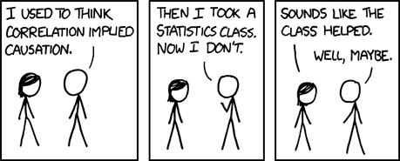
Correlation vs. causation
https://xkcd.com/552/

Slide 6
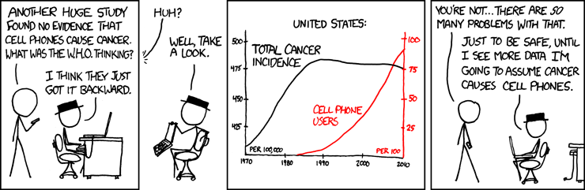
Causal direction
https://xkcd.com/925/

Slide 7
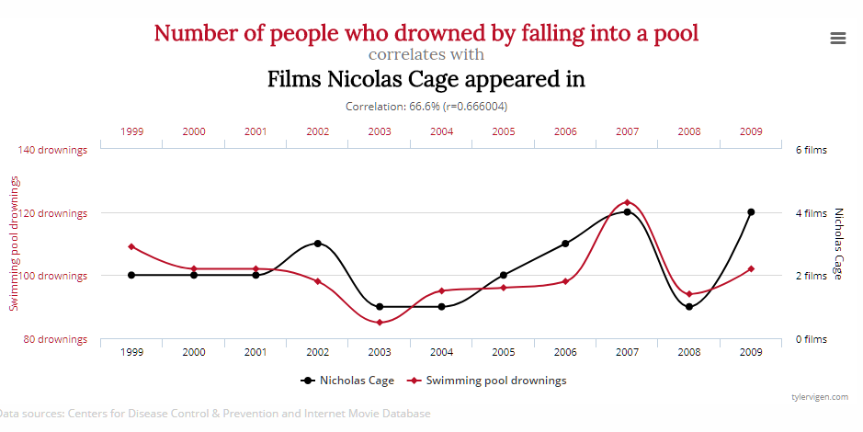
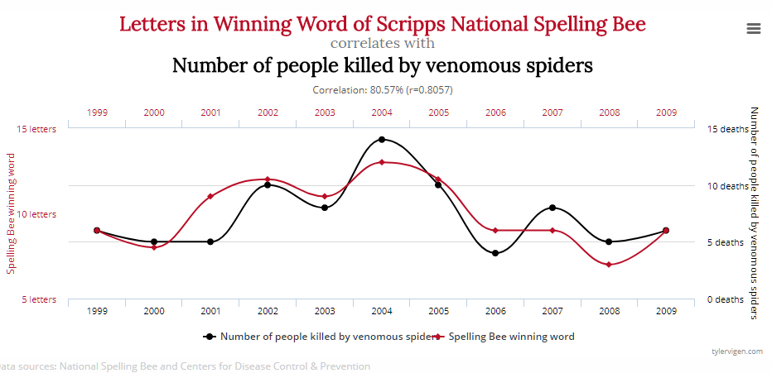
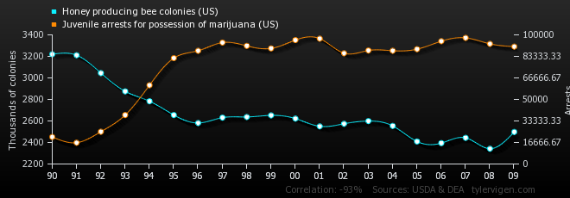
Spurious correlations
http://www.tylervigen.com/spurious-correlations

Slide 8
Activity 1
How spurious are these correlations?
Why are they not believable? What would it mean if there was a causal relationship?
http://tylervigen.com/page?page=2
Also, guess the correlation
http://guessthecorrelation.com/

Slide 9
Validity
Conclusion validity: is there a relationship between the variables of interest?
Internal validity: is the observed relationship a causal relationship?
Construct validity: did you measure what you thought you measured?
External validity: does the relationship observed generalize to other people, places, and times?

Slide 10
Internal validity
https://www.socialresearchmethods.net/kb/causeeff.php
There are many factors outside of a researcher’s control that can change behavior → how to rule them out?
Causal requirements
Temporal precedence: cause has to happen before effect
Covariation: if more treatment, then more outcome; if less treatment, then less outcome
Alternative explanations: single group threats, multiple group threats, and social interaction threats
Experimental design and causal inference methods
Blocked, factorial, etc.
Matching, differencing, discontinuities, instrumental variables, etc.
Example: Cannabis sales predict snowfall in the winter.

Slide 11
Hill (1965) Association or Causation?
http://livefreeordichotomize.com/2016/12/15/hill-for-the-data-scientist-an-xkcd-story/
Strength: How big is effect you are measuring? (Large effects imply causality, but small effects also can)
Consistency: Can the effect be replicated? (Causal effects should be reproducible)
Specificity: Can association be pinpointed? (No other mechanisms should plausibly explain)
Temporality: Do the causes come before effects? (No time traveling)
Gradient: Do stronger/weaker treatments cause greater/lesser effects? (Same as covariation)
Plausibility: Does the causal mechanism itself make sense? (How could Cage films cause drowning?)
Coherence: Is the causal mechanism compatible with other evidence?
Experiment: Can experiments reproduce the effect?
Analogy: Is the causal mechanism similar to other established mechanisms?

Slide 12
Threats to internal validity – single group
https://www.socialresearchmethods.net/kb/intsing.php
RQ: “Does cannabis legalization reduce opioid overdoses?”
Design: Measure per-capita opioid overdoses in before and after 2014 legalization
History: Legalization didn’t cause reduction in overdoses, an unrelated 2014 mental health program did
Maturation: Risky behavior goes down as people age, overdoses went down because population got older
Testing: Asking about opioid consumption before 2014 caused people to consume/overdose
Instrumentation: Method for measuring opioid overdoses changed between 2010 and 2018
Mortality: People reporting in 2010 left Colorado before 2014, so measuring different people afterwards
Regression: Opioid overdoses were unusually high around 2010, they could only come down

Slide 13
Threats to internal validity – multiple group
https://www.socialresearchmethods.net/kb/intsing.php
A similar control group that doesn’t receive treatment is ideal, but has its own challenges:
Treatment and control groups must be comparable → selection threats cause groups to not be comparable
Design #2: Measure opioid overdoses before and after 2014 legalization by comparing to opioid overdoses in a similar state that did not legalize (Colorado vs. Michigan)
History: Population in CO reacts to Obama’s 2012 re-election differently than MI, CO has less abuse
Maturation: Population in CO matures faster than MI, MI has greater risk taking behavior around opioids
Testing: Pre-2014 surveys caused MI people to be more likely to start abusing opioids
Instrumentation: Method for measuring overdoses differs between CO and MI
Mortality: At-risk people in CO are more likely to move than MI, more of them to drop out of statistics
Regression: MI had unusually high rates that had to come down, regardless of treatment/control

Slide 14
Threats to internal validity – social interaction
https://www.socialresearchmethods.net/kb/intsoc.php
People do not exist in isolation, they react to others’ behavior which can interfere with the experiment
Design #2: Measure opioid overdoses before and after 2014 legalization by comparing to opioid overdoses in a similar state that did not legalize (Colorado vs. Michigan)
Diffusion/Imitation of Treatment: Comparison state sees CO effects, MI cannabis prohibition becomes lax
Compensatory Rivalry: Comparison state sees CO effects, MI starts new program to reduce overdoses
Resentful Demoralization: Comparison state sees CO effects, MI increases prohibition policies
Compensatory Equalization: Federal agency sees CO effects, increases support to MI

Slide 15
Alternative causal relationships
You observe a correlation between X and Y
A
X
Y
X
Y
X
Y
Simple Causation
X causes Y
Reverse Causation
Y causes X
Confounding
A causes X and Y
A
A
Y
Y
X
A
Y
X
X
Mediation
X causes A which causes Y
Multiple causation
X and A causes Y
Interaction
X causes A and Y, A causes Y

Slide 16
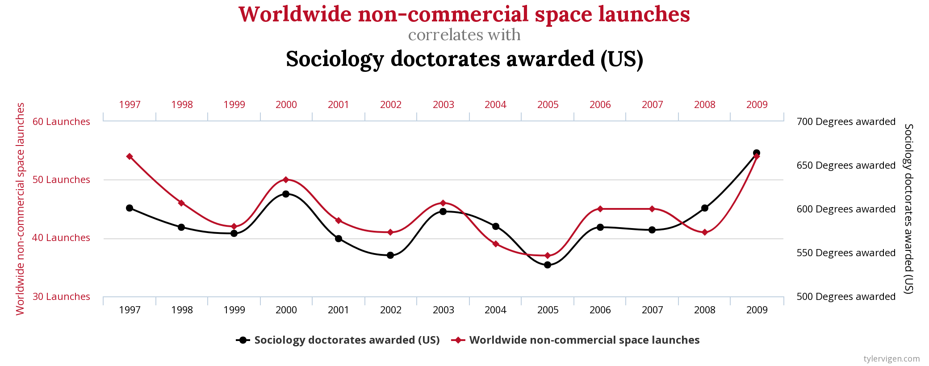
Alternative causal relationships

Slide 17
Alternative causal relationships
Correlation between space launches and sociology docotates
A
X
Y
X
Y
X
Y
Simple Causation
PhDs (X) cause launches (Y)
Reverse Causation
Launches (Y) cause PhDs (X)
Confounding
Funding (A) causes PhDs (X) and launches (Y)
A
A
Y
Y
X
A
Y
X
X
Mediation
PhDs (X) causes researchers (A),
which causes launches (Y)
Multiple causation
PhDs (X) and crew dynamics (A) causeslaunches (Y)
Interaction
PhDs (X) cause researchers (A)
and launches (Y),
researchers (A) cause launches (Y)

Slide 18
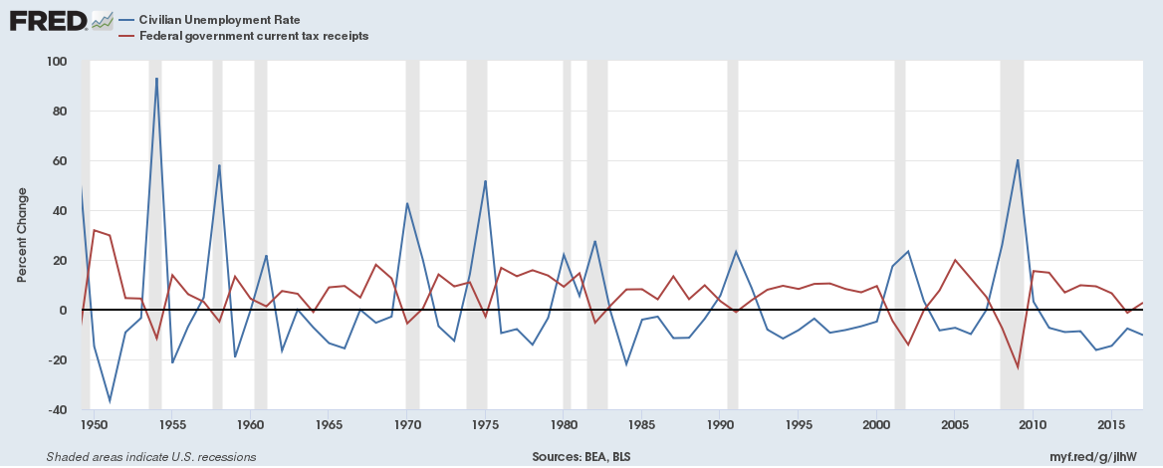
More substantive relationship

Slide 19
Alternative causal relationships
When unemployment goes up, tax revenue goes down
A
X
Y
X
Y
X
Y
Simple Causation
X causes Y
Reverse Causation
Y causes X
Confounding
A causes X and Y
A
A
Y
Y
X
A
Y
X
X
Mediation
X causes A which causes Y
Multiple causation
X and A causes Y
Interaction
X causes A and Y, A causes Y

Slide 20
Writing and presenting about causality
Miller (2015), Chicago Guide to Writing About Numbers, pg. 59.
Describe plausible mechanisms linking the hypothesized cause to its effect
Discuss threats to proposed causal relationship
Hill framework, internal validity threats, alternative causal configurations, biased data, etc.
Explain how your statistical methods overcome drawbacks of observational data
Separate course needed to cover causal inference from observational data!
Matching, instrumental variables, regression discontinuity, difference-in-differences

Slide 21
Non-Activity 2
Specify the research question: “Does cannabis legalization cause reduction in opioid use?”
Describe causal mechanism: “Cannabis has effects that substitute for dangerous drugs”
Describe data and research design: “Use Medicare data to measure whether states had less opioid usage after cannabis legalization compared to states that didn’t change their rules”
Discuss threats to causality: Confounding, multiple causation, instrumentation, compensatory rivalry

